Slide 1
TEAM 2 -TERM 4
The JMAC Group
Corey Johnson
Joe Pfankuch
Maria Martinez
Andrea Ceste

Slide 2
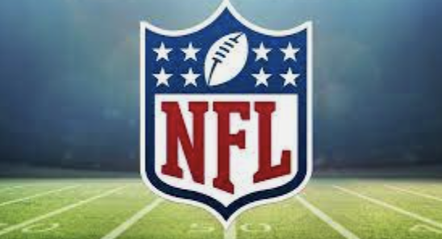
Analysis of NFL Data for team purchase
Assignment a team score/rating based upon:
Team Valuation
Growth in Team Valuation from 2014-2021
Season Stats
Percentage of Wins
Ticket Sales
Player Value
Payroll
Fines
Offensive Power
Sports team market
Sites scraped:
Wikipedia
NFLSavant
ESPN
World Population Review
NFL.com
Thephinsider
Spotrac
GitHub
Statista
Notes:
Short introduction to the dataset and your reason for selecting it as a domain of inquiry.

Slide 3
Final | Factors
15 | Valuation
15 | Win%
15 | Ticket Sales
5 | Increase
5 | Fines
10 | Player Value
15 | Season Stats
5 | Offensive Power
10 | Payroll
5 | STM
Total 100

Slide 4
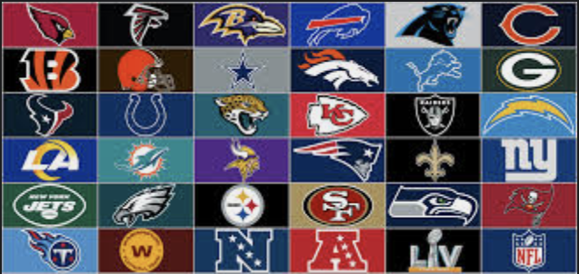
Null Hypothesis
The team with the highest percentage of wins is not the team with the highest valuation.
Notes:
Summary of the method (statistical testing) you used, your results, and the potential applications for the business. Statistical testing as your method of insight, you will need to: articulate your null and alternative hypotheses, explain the meaning of the result of the test, and its ramifications for the business. Also include high level observations, conclusions, or recommendations you might make to the stakeholder group on the basis of the analysis you’ve generated.

Slide 5
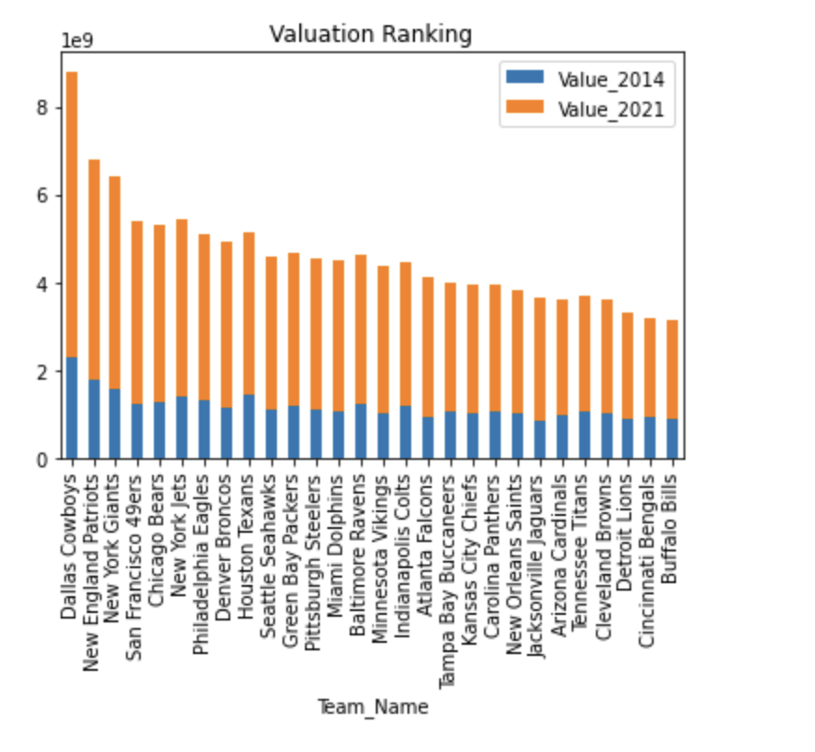
Team Valuation (points basis 15)
Teams rated by valuation and year 2014 and year 2021.
Teams received a rating from zero to fifteen based on total valuation.
Sites scraped:

Slide 6
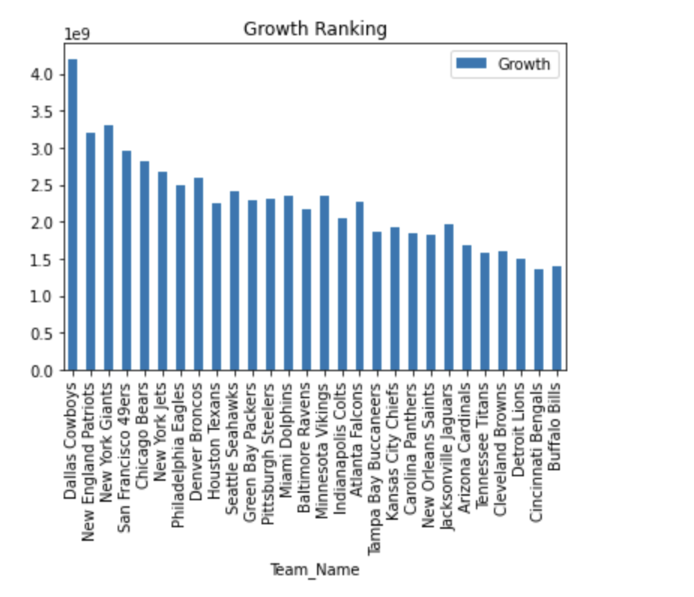
Growth in Team Valuation 2014-2021 (points basis 5)
Teams rated by growth in valuation between year 2014 and year 2021.
Teams received a rating from zero to five based on growth in total valuation.
Sites scraped:

Slide 7
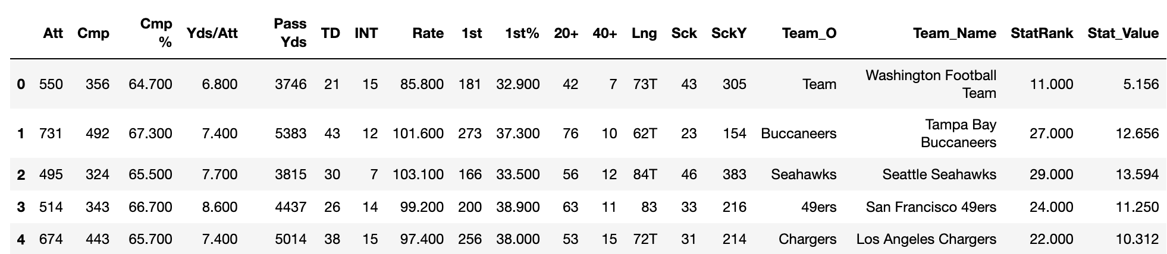
Season Stats (points basis 15)
Teams rated by season 2021 stats – passer rating.

Slide 8
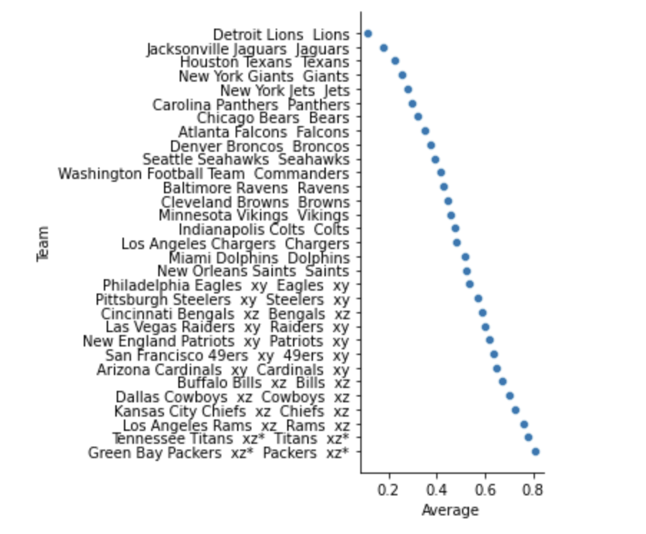
Percentage of wins 2001-2021 (points basis 15)
Teams rated by average winning percentage from 2001-2021.
Teams received a rating from zero to fifteen.

Slide 9
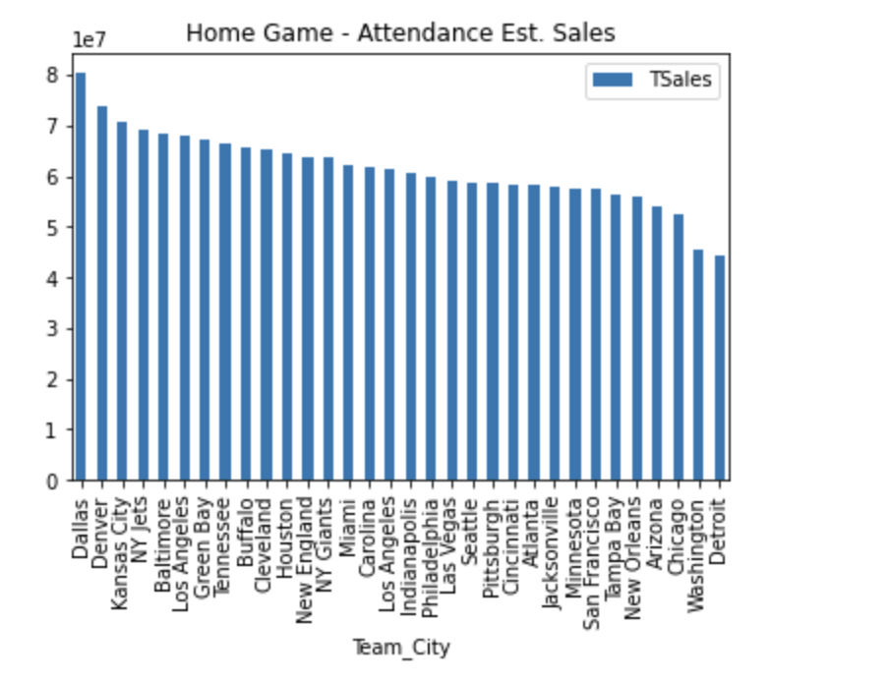
Ticket Sales (points basis 15)
Teams rated on estimated ticket sales based on home game attendance.
Ticket cost based on 2021 average of $107.50.
Teams received a rating from zero to fifteen.

Slide 10
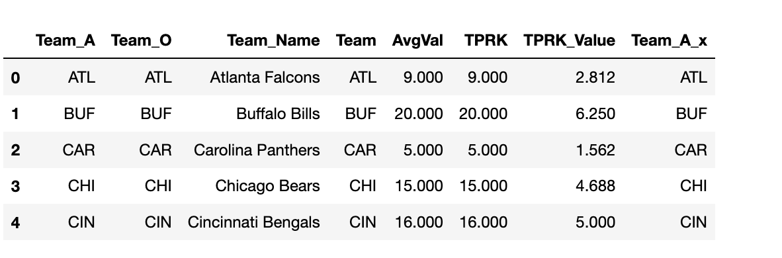
Player Value (points basis 10)
Teams rated on market value of their players.
Teams received a rating from zero to ten.
Notes:
Cell 25

Slide 11
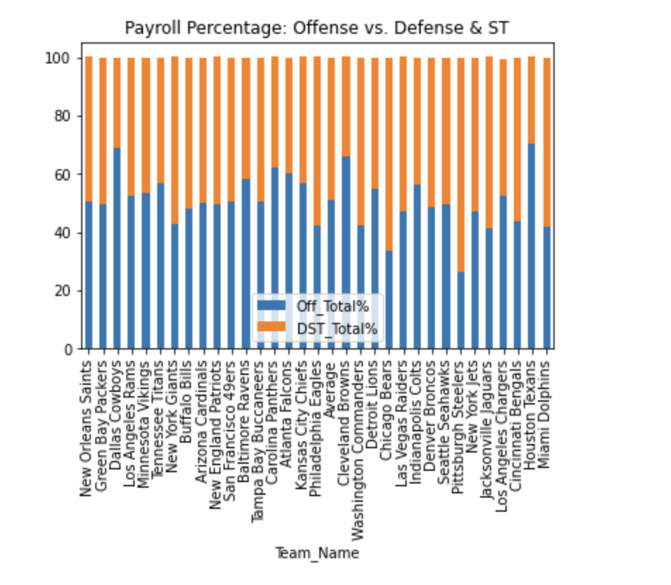
Payroll (points basis 10)
Teams rated on total projected payroll for 2021 – separated by positions.
Diagram reflects the percentage spent on offense, defense, and special teams.
Teams received a rating from zero to ten.

Slide 12
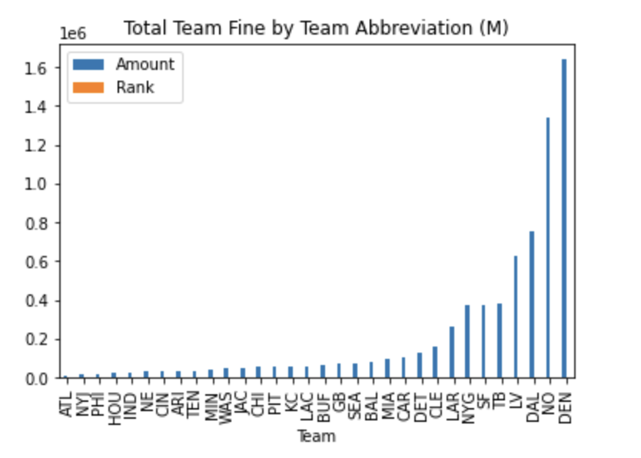
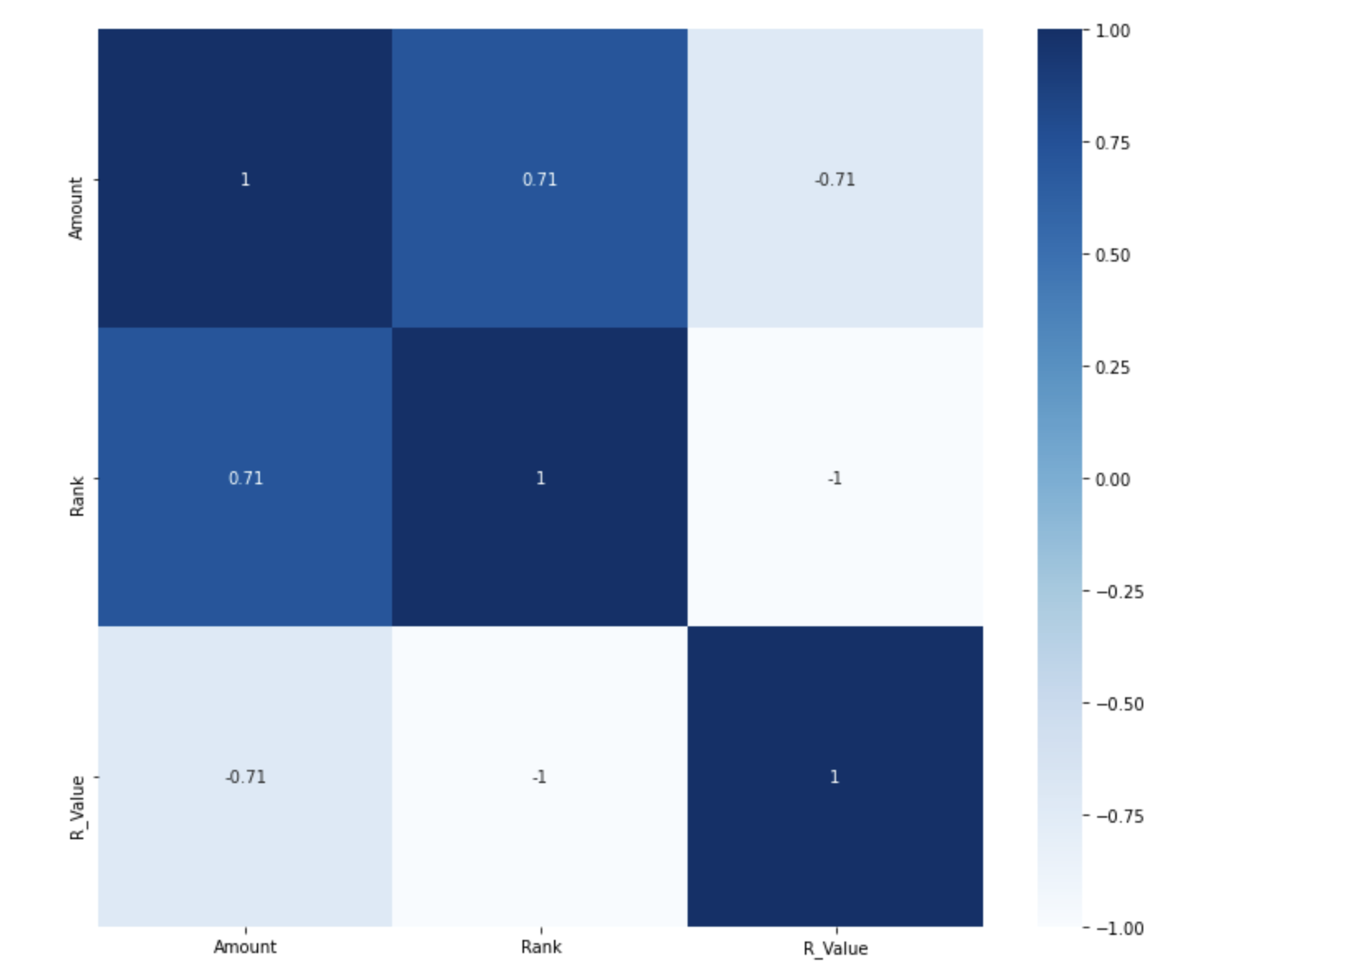
Fines (points basis 5)
Teams rated on total amount of fines incurred (millions).
Correlation map reflects the relationship between the team rank and the amount.
Teams received a rating from zero to five.
Notes:
Correlation of Position Value to Finding the right team payroll composition The correlation coefficient has values between -1 to 1 — A value closer to 0 implies weaker correlation (exact 0 implying no correlation) — A value closer to 1 implies stronger positive correlation — A value closer to -1 implies stronger negative correlation The correclation reflects the relationship between players being fined and the team's total fines.

Slide 13
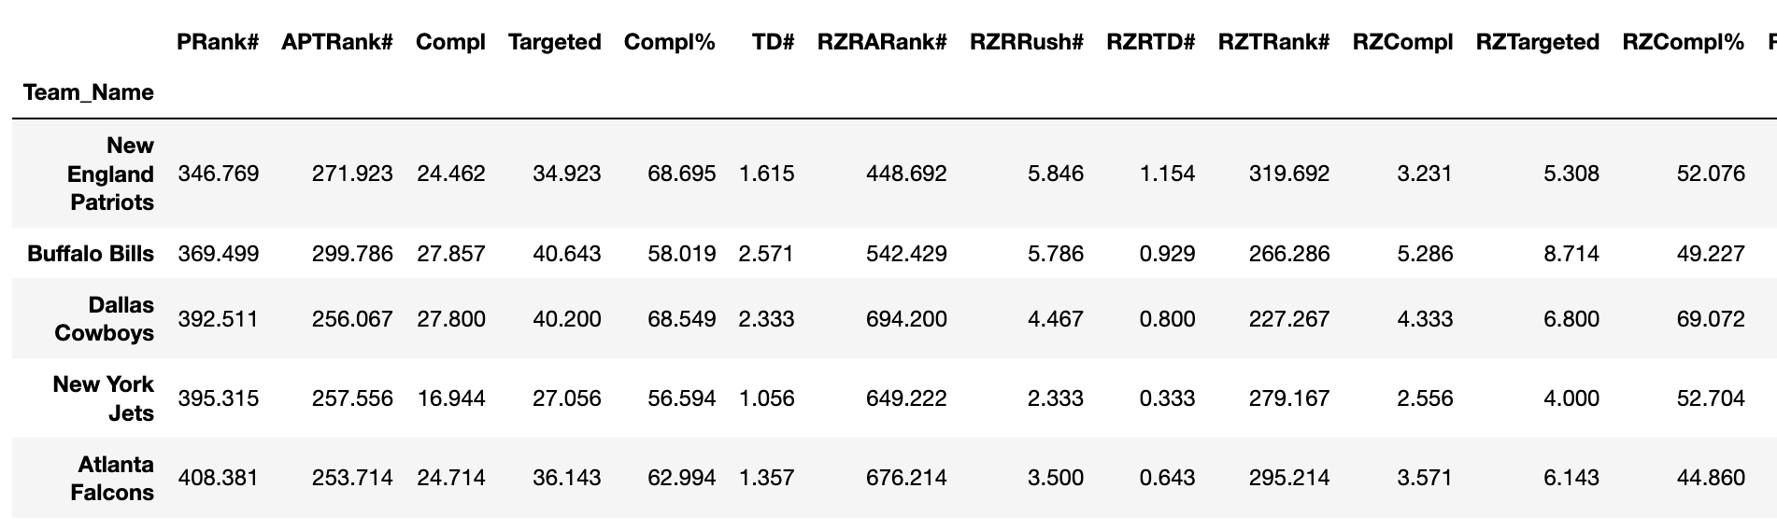
Offensive Power (points basis 5)
Teams rated on impact of offensive power.
Ranking based on all passing attempts, all red zone rushing attempts, all red zone passing attempts.
Teams received a rating from zero to five.

Slide 14
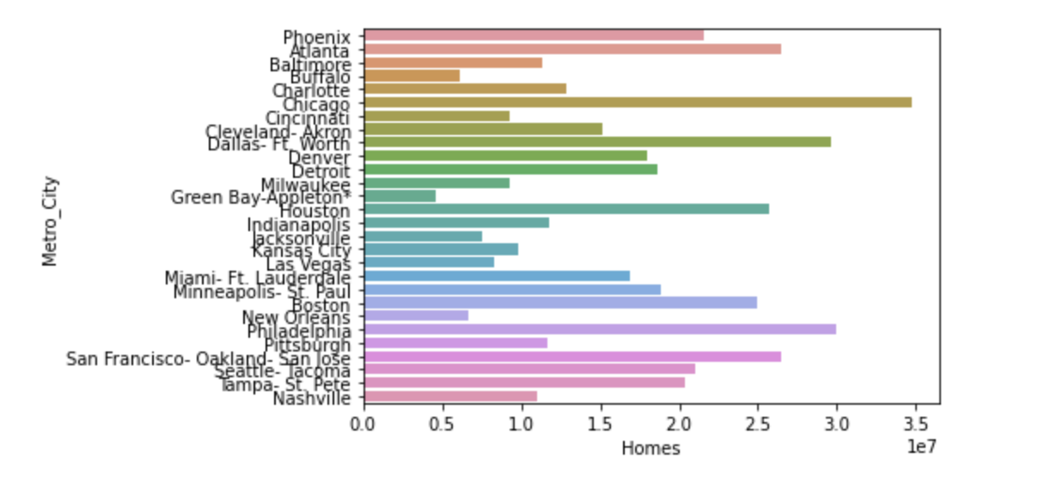
Sports Team Market (points basis 5)
Teams rated by Nielsen TV market size.
Diagram reflects metropolitan area based on number of homes.
Teams received a rating from zero to five.

Slide 15
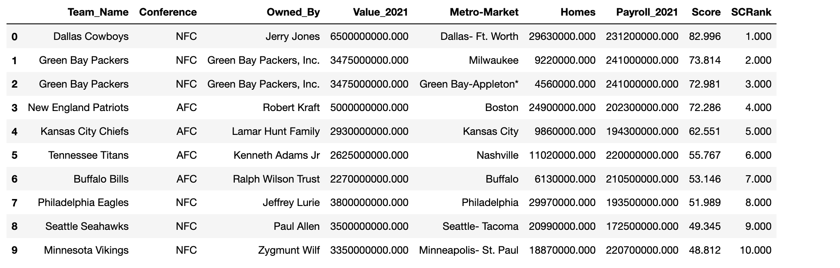
Results
The final team scores are a sum of all ranking values. Final score is out of 100 points.
The table below reflects the top 10 results.
*The Green Bay Packers are listed twice because they are listed in two metropolitan areas.

Slide 16
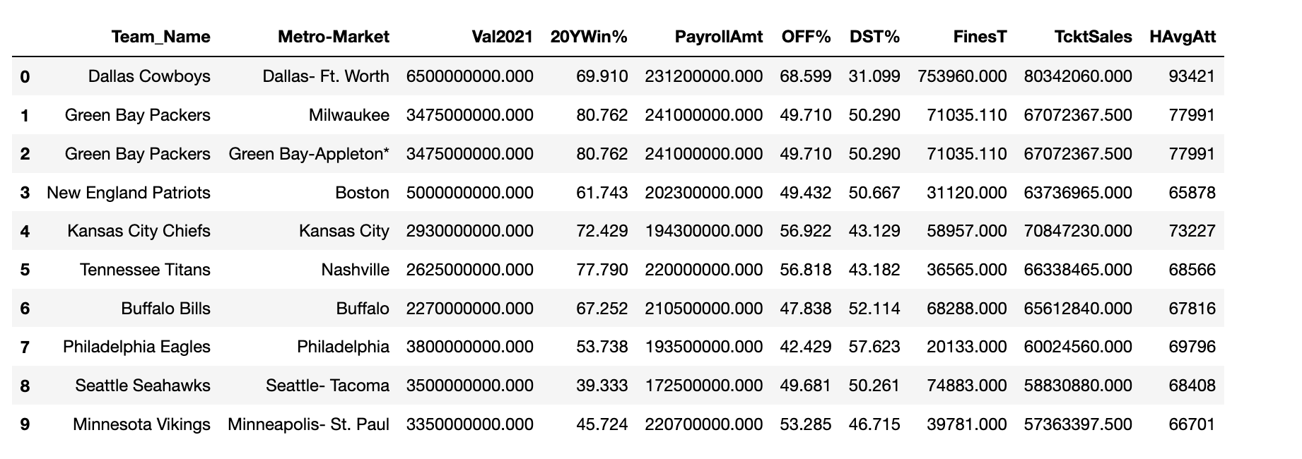
Hypothesis Results
Hypothesis: The team with the highest percentage of wins is not the team with the highest valuation.
We accept this hypothesis because even though the Dallas Cowboys have the highest valuation, they are not the team with the highest percentage of wins.

Slide 17
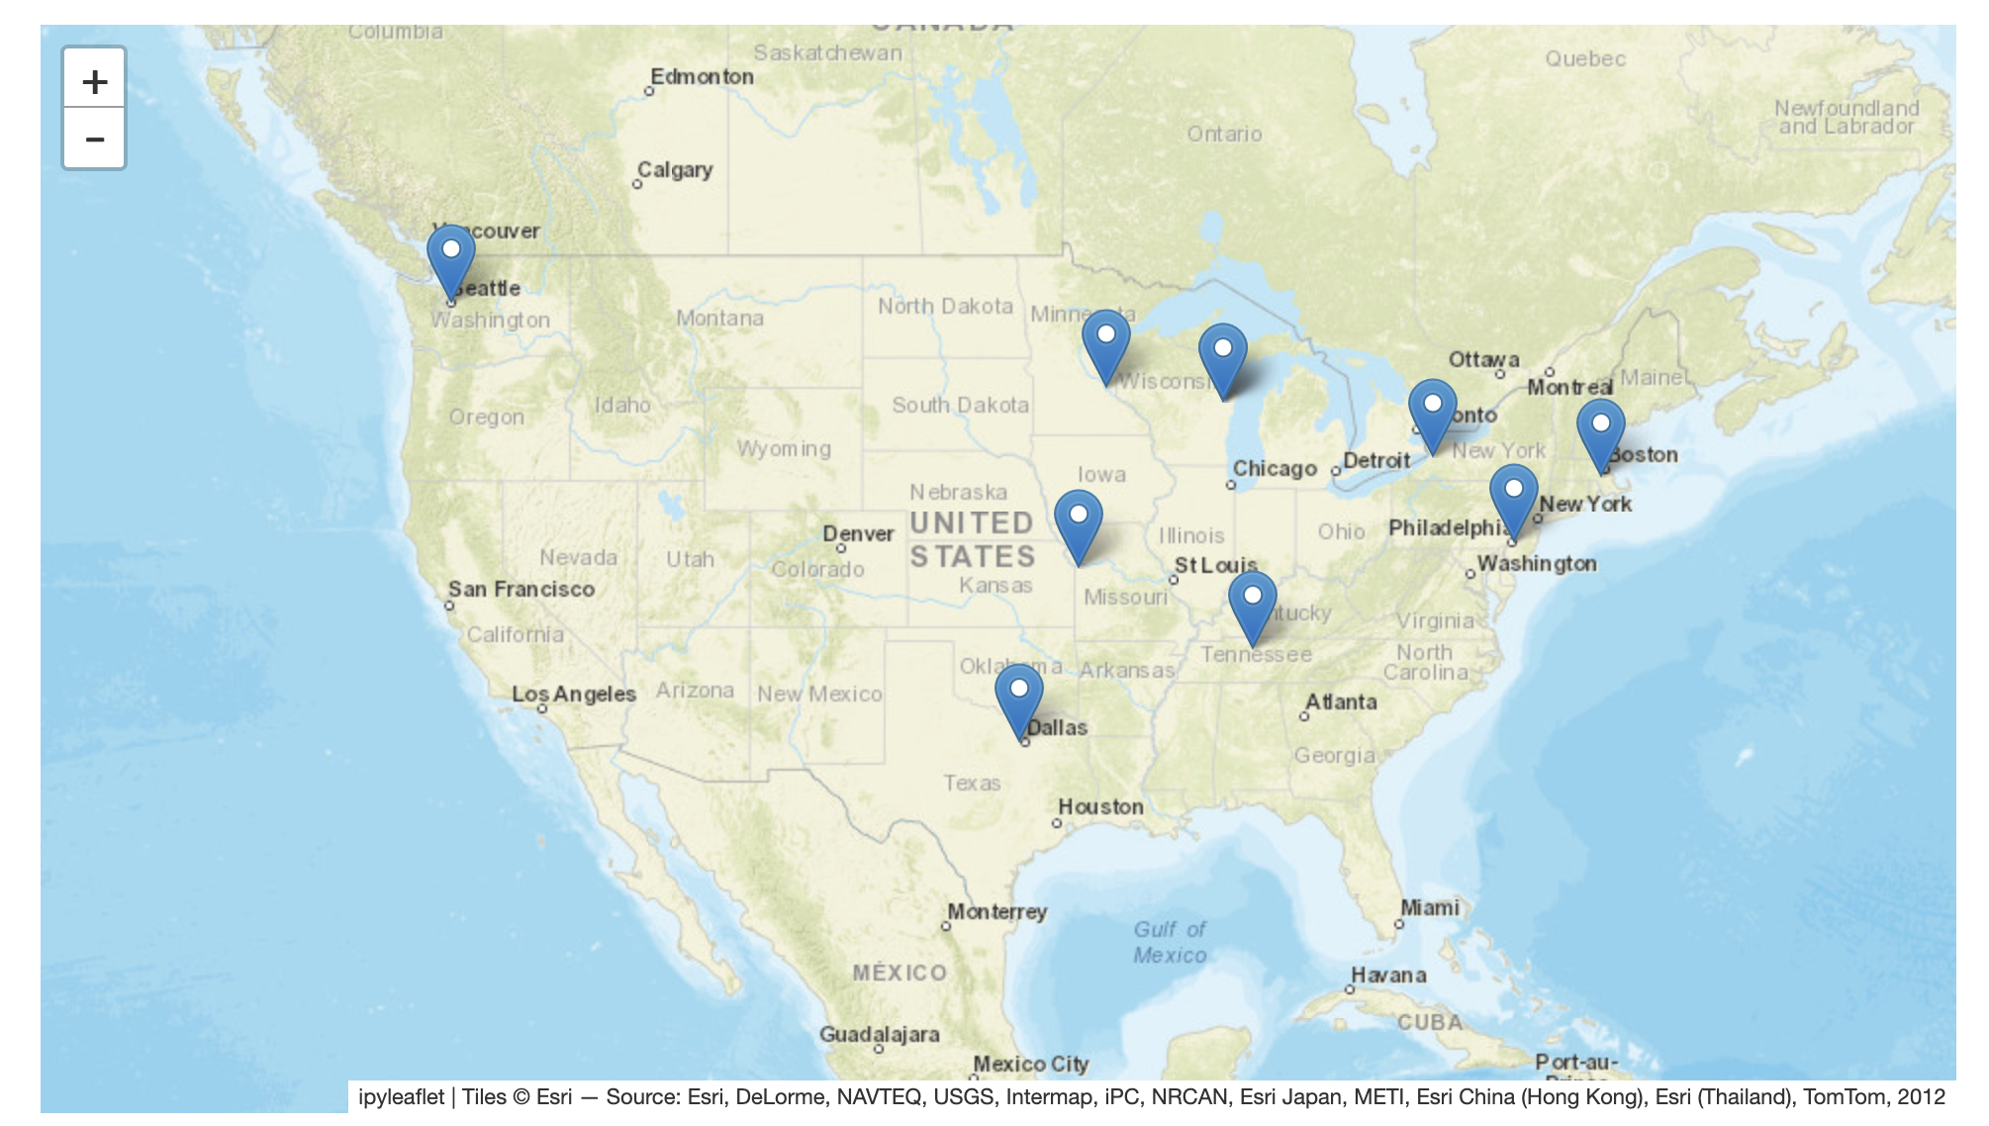
Stadium Locations on Buyer List
Recommendation:
Based on all of the team information, winning percentage, and final score, we are recommending purchase of the Green Bay Packers.

